Slide 1
Virtual Conference
Sub-Theme: Circular Economy
4th National Conference of Chief Secretaries
Preparation of Feedback Notes and State-specific Notes
Ministry of Environment, Forest and Climate Change
Government of India
(26.09.2024)

Slide 2
Overall Process for the Conference & Timeline
Identification of Themes & Nodal Ministries
Formation of Working Groups by Nodal Ministries
Concept Note by Nodal Ministry
Feedback Notes and State Specific Notes by States*
Background Note by
Nodal Ministry
Workshops by Nodal Ministries with States & UTs and other Stakeholders*
Finalisation of all elements of the programme
November 2024
31 October 2024
Sep - Oct 2024
August 2024
August 2024
July 2024
July 2024
*inputs from States/UTs to incorporate all grassroot experiences, suggestions & innovative solutions

Slide 3
Workshop with States/UTs & other Stakeholders
1st Workshop: 21.08.2024 (Virtual)
2nd Workshop: 29.08.2024 (In-Person)
Objective: Dissemination of concept note, discussion on key issues, enable Sates/UTs to further engage with local departments/functionaries for preparation of Feedback notes and State Specific Notes
3rd Workshop: 26.09.2024 (Virtual)
Objective: Facilitate preparation of Feedback notes & State Specific Notes and uploading them on the portal

Slide 4
Reference Documents Shared with States/ UTs
Concept Note
Template for Feedback Note
Template for State-specific Note
Process to upload compiled Feedback Note
All documents shared with States/UTs

Slide 5
Documents to be Prepared – State/UT level
Sl No | Document | Description | Deadline
1 | Feedback Note | ~2 pages (as per Template provided by NITI Aayog) To be prepared by all officers and State Department/ local functionaries officers Covering policy gaps & challenges, potential solutions, best practices Vetted summary of these notes to be uploaded by State/ UT on web portal & shared with MoEFCC ~50 feedback notes to be shared by each State/ UT | 1 September to 5 October, 2024
2 | State Specific Note | ~5 pages (as per Template provided by NITI Aayog) To be prepared by States/ UTs based on: Two Pager Feedback Note State-specific inputs obtained from workshop with stakeholders and experts State Specific Note to also be uploaded by the State/UT on the web portal and shared with MoEFCC | 15 October, 2024

Slide 6
Expected Outcome - Each States/UTs
Collect at least 50 feedback notes from all officers - Each IAS Officer/ State/ UT Govt. officer needs to fill the feedback note on at least one of the sub-themes
Compile all the feedback notes
Every State/ UT has to upload a Compiled Feedback Note (comprising all feedback notes) on the web portal
Every State/UT has to prepare a State-Specific Note w.r.t all 12 identified waste streams
State-Specific Note to be uploaded on the web portal
Compiled Feedback Notes & State-Specific Note to be shared with MoEFCC also
States/UTs to nominate Nodal Officers for Circular Economy sub-theme
(Official nominations received from 06 States; while 21 states and 5 UTs informed telephonically)

Slide 7
Potential Stakeholders – State/UT Level
Industry Department
Urban Development
Rural Department
Environment Department
SPCB/PCC
Labor Department
State Skill Development Corporation
District Magistrate
Sub-Divisional Magistrate
Block Development Officer
CEO, Zilla Parishad

Slide 8
Discussion - Questions?

Slide 9
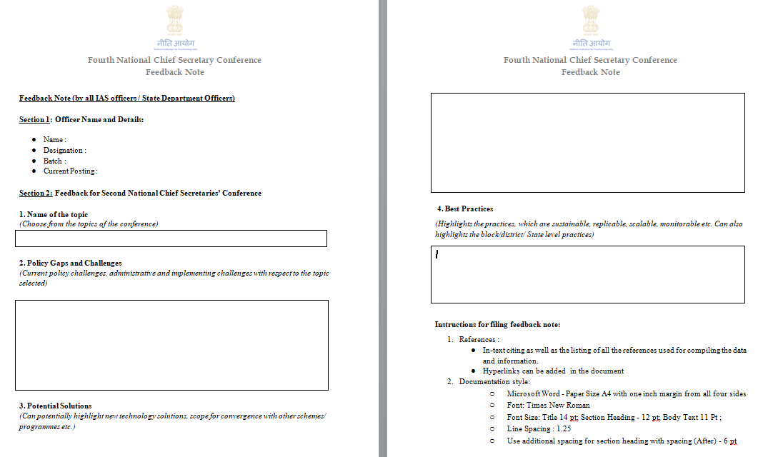
Template – Feedback Note by Officers

Slide 10
Template – Feedback Note by Officers
Name of the topic : Choose from the topics of the conference
Policy Gaps and Challenges: Current policy challenges, administrative and implementing challenges with respect to the topic selected
Potential Solutions: Can potentially highlight new technology solutions, scope for convergence with other schemes/ programmes etc.
Best Practices: Highlight practices which are sustainable, replicable, scalable, monitorable etc, including the block/district/ State level practices

Slide 11
Instructions for Filling Feedback Note
References :
In-text citing as well as the listing of all the references used for compiling the data and information
Hyperlinks can be added in the document
Documentation style:
Microsoft Word - Paper Size A4 with one inch margin from all four sides
Font: Times New Roman
Font Size: Title 14 pt; Section Heading - 12 pt; Body Text 11 Pt ;
Line Spacing : 1.25
Use additional spacing for section heading with spacing (After) - 6 pt

Slide 12
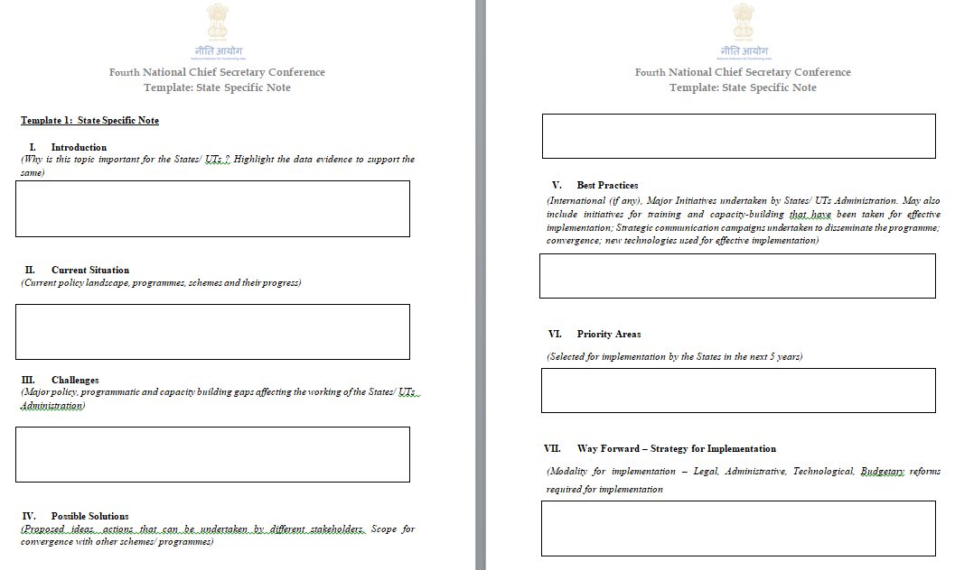
Template – State Specific Note by all States/UTs

Slide 13
Template – State Specific Note by all States/UTs
Introduction: Why is this topic important for the States/ UTs ? Highlight the data evidence to support the same
Current Situation: Current policy landscape, programmes, schemes and their progress
Challenges: Major policy, programmatic and capacity building gaps affecting the working of the States/ UTs Administration
Possible Solutions: Proposed ideas, actions that can be undertaken by different stakeholders. Scope for convergence with other schemes/ programmes
Best Practices: International (if any), Major Initiatives undertaken by States/ UTs Administration
Priority Areas: Selected for implementation by the States in the next 5 years
Way Forward (Strategy for Implementation): Modality for implementation–Legal, Administrative, Technological, Budgetary reforms required for implementation

Slide 14
Instructions for Filling State Specific Note
References :
In-text citing as well as the listing of all the references used for compiling the data and information
Hyperlinks can be added in the document
Documentation style:
Microsoft Word - Paper Size A4 with one inch margin from all four sides
Font: Times New Roman
Font Size: Title 14 pt; Section Heading - 12 pt; Body Text 11 Pt;
Line Spacing : 1.25
Use additional spacing for section heading with spacing (After) - 6 pt

Slide 15
Instructions for filling State Specific Note
Any case study on the impact of the initiatives (District/State level) undertaken may be shared (along with high resolution photographs). Alternatively, short films on the initiatives may be shared
Photographs and snapshots/Screenshots of the Virtual Conferences along with broad participant list may be shared
If the State has worked out any long term vision for the next 25 years, details of the same along with Implementation strategy may be shared

Slide 16
Web Portal for CS Conference
Facilitates Knowledge Exchange & Monitoring Action Taken
Knowledge Repository: All material pertaining to the 1st , 2nd & 3rd CS Conference (concept notes, background notes, state specific notes, feedback notes, presentations, minutes, etc.) uploaded on the web portal, https://ncsconf.gov.in
Monitoring Platform: All Nodal Ministries upload the Action Taken Report on the portal.
Login Based Access: provided by NITI Aayog to Nodal Officer from each State/ UT
Documents to be uploaded on the portal:
Concept Notes & Background Notes – Nodal Officer, MoEFCC
Feedback Notes & State Specific Notes – Nodal Officer, respective States and UTs

Slide 17
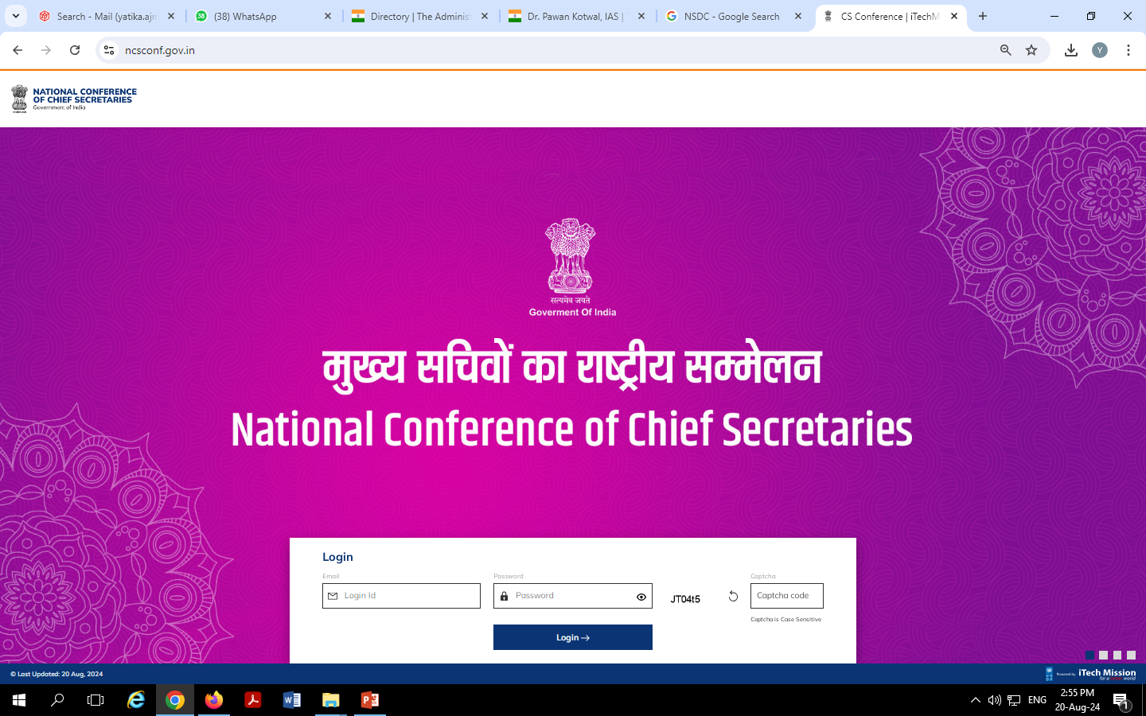
Web Portal for CS Conference

Slide 18
Process for Uploading Compiled Feedback Note
Feedback note should be digitally filled by the officer in the template shared and saved as a PDF document
Feedback note may be shared by the concerned officers to the nodal person in the State Government
Feedback notes of similar topics have to be merged in an alphabetical order in the order of the name of the officer, along with a summary
Compilation of the feedback note will form a single Compiled Feedback Note, and named in the following manner “CFN_^State/UT name^_^Theme Number^”
Compiled Feedback Note to be uploaded by the state on the web portal

Slide 19
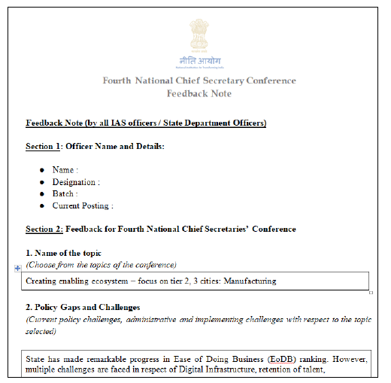
Process for Uploading Compiled Feedback Note
Every State/ UT has to upload a Compiled Feedback Note comprising feedback notes from all Officers at State level.
In every State/UT, Every IAS Officer/ State Government officer needs to fill the feedback note on at least one of the sub-themes.
Example ------------>

Slide 20
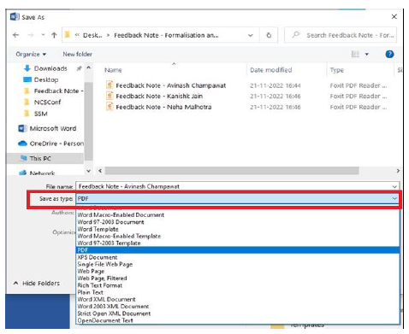
Contd…
3. The feedback note should be digitally filled by the officer in the template shared and saved as a PDF document by choosing PDF as the file type under the “Save As” option of Microsoft Word (Refer screenshot below)
NOTE: Please DO NOT scan documents or pictures to make a PDF
4. The feedback note may be shared by the concerned officers to the nodal person in the State Government.

Slide 21
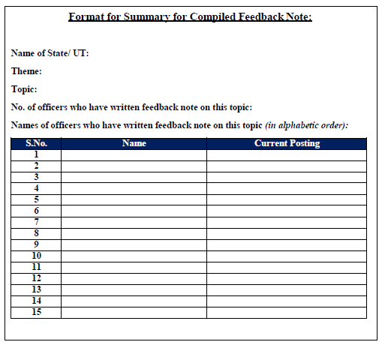
Contd…
5. Feedback notes of similar topics have to be merged in an alphabetical order in the order of the name of the officer, along with a summary (Refer below format for Summary).

Slide 22
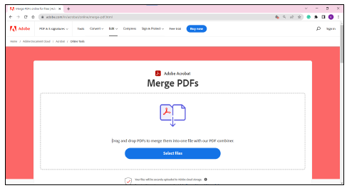
Contd…
6. Such merging can be done via an online platform (https://www.adobe.com/in/acrobat/online/merge-pdf.html) or through Adobe Acrobat Pro licensed version.
For the online process, please follow the steps below:
a. On your internet browser, go to Adobe Merge PDF webpage (https://www.adobe.com/in/acrobat/online/merge-pdf.html), and click on “Select Files”

Slide 23
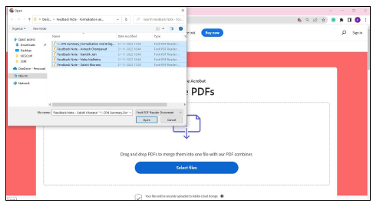
Contd…
b. After clicking on “Select Files”, a pop up will appear to select files from your system. Please select the feedback notes of one topic along with the summary file depicting list of officer of that topic.

Slide 24
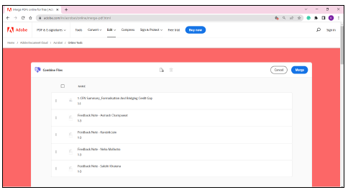
Contd…
c. After selecting the files, they will appear in the web portal for merging. Kindly rearrange the files in such a manner that the “summary file (Refer Annexure 1)” is placed first followed by the feedback notes in an alphabetical order of the name of the officers. After which, click Merge on the top-right corner of the screen.

Slide 25
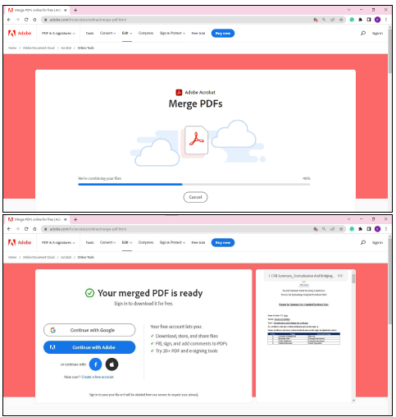
Contd…
d. After Merging, the final PDF will appear for downloading. Kindly download that file in your system.

Slide 26
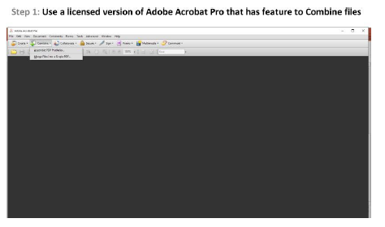
Contd…
For the offline process, please follow the steps below:

Slide 27
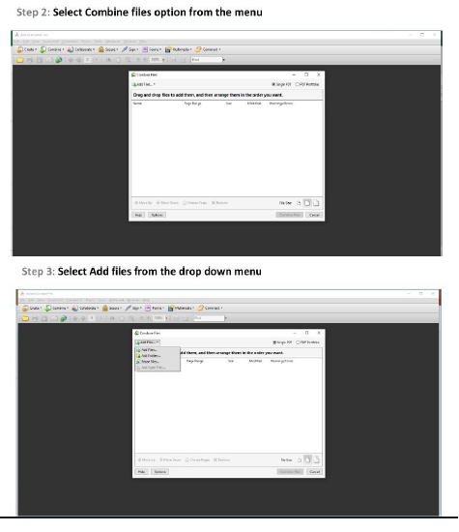
Contd…

Slide 28
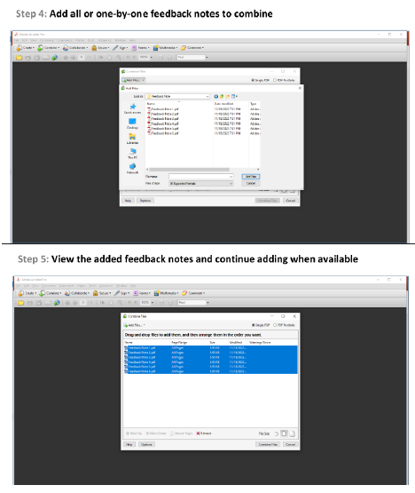
Contd..

Slide 29
Contd…

Slide 30
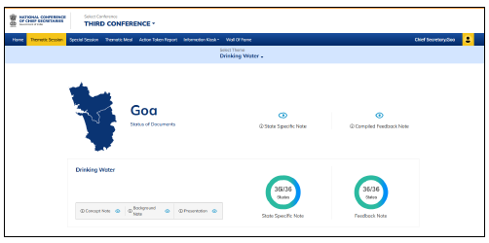
Contd…
7. After downloading/saving the combined file, the compilation of the feedback note should be called Compiled Feedback Note, and named in the following manner “CFN_^State/UT name^_^Theme Number^”
(Example, PDF file containing compiled feedback note of State of Goa for Theme „Manufacturing‟ will be named “CFN_Goa_Theme1”)
8. The compiled Feedback Note should be uploaded by the state on the web portal.
(For reference, Refer screenshot)
9. The above-mentioned process has to be repeated for all sub-themes for the 4th National Conference of Chief Secretaries.

